Slide 1

EXCECUTIVE SUMMARY

Slide 2
Problem Statement
Green Destination is a well known travel agency. The HR Director has recently noticed an increase in employees leaving(attrition). She would figure out any trends or patterns. She has surveyed the staff of Green Destinations and provided the data.
She would like to know the attrition rate (% of people who left the company).
She would also know if factors like age, years at the company and income play a part in determining if people will leave or not.

Slide 3
Key Performance Indicators
Total Employees.
Active Employees.
Attrition Count.
Attrition Rate %.
Average Monthly Income.

Slide 4
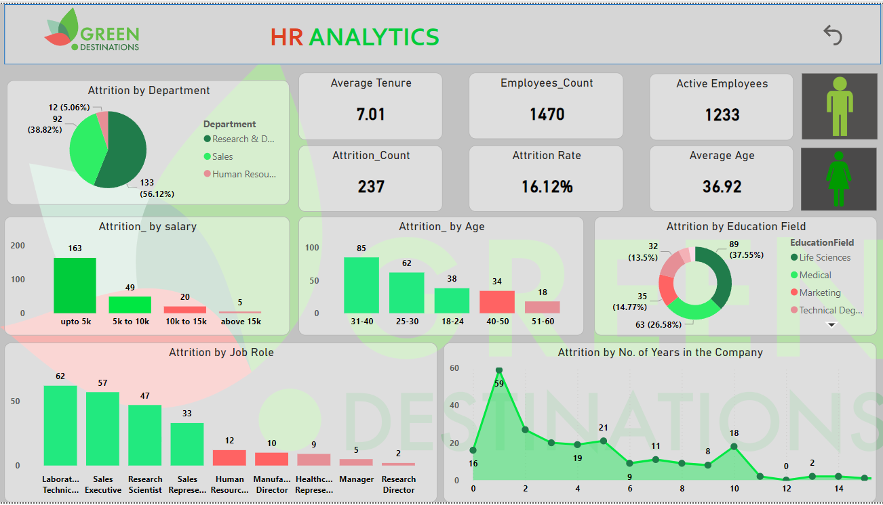
Dashboard

Slide 5
Insights
Attrition rate at 16.2%
Males have high attrition count.
Research & Development Department has high employee attrition
Age group between 30-40 has high attrition.
Most employees left at 1 year mark – 59 employees
Employees who earned between 5k-10k have high attrition
Laboratory research roles have the highest attrition count

Slide 6
Recommendations and improvement techniques
The dashboard provides helpful suggestions to reduce attrition, such as:
Employee engagement program: Implement programs to increase employee engagement and satisfaction.
Career development plans: Yield advancement opportunities and a clear career path.
Compensation and Benefits Evaluation: To remain competitive, compensation and benefits must be evaluated regularly.
Flexible working Arrangements: Offer flexible working arrangements to improve work-life balance

